Slide 1

DIGITAL CLASSROOM
Team Members :
Himani Rathi
Puneet Saluja
Tanmay Sonkusle

Slide 2
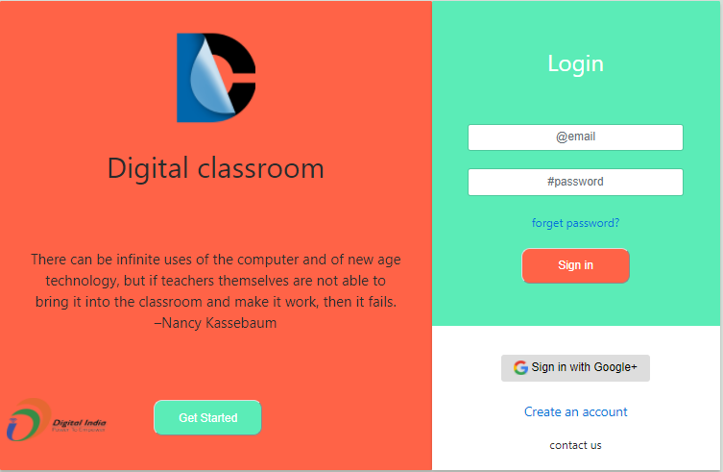

Slide 3
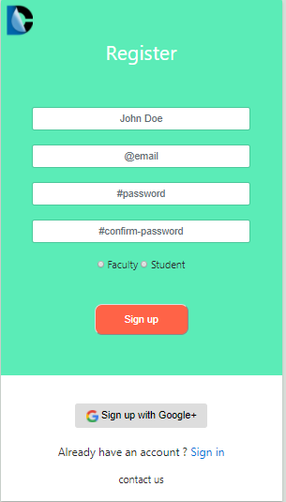
Register Account
User can register as a faculty and student.
Login with Google+.
Teacher Account is verified by Admin.

Slide 4
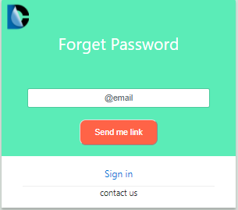
Forget Password
Verification of user by email.
Email is sent to user’s email address and he can enter OTP received by him to Login again.

Slide 5
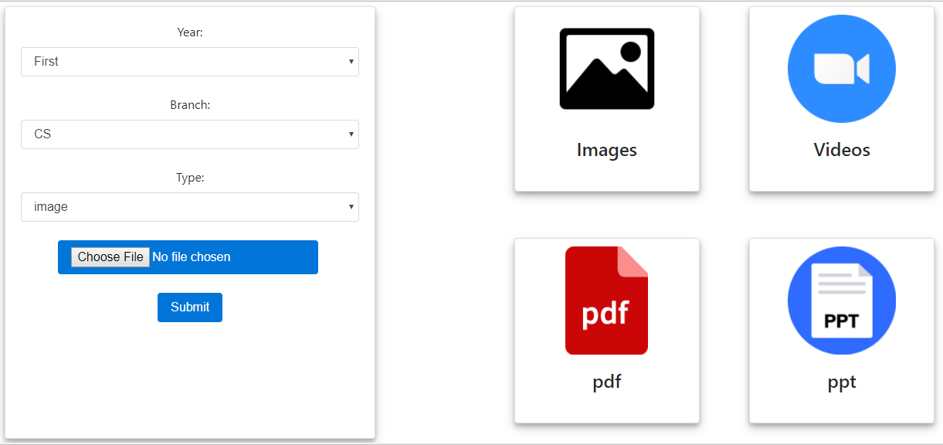
Teacher’s Dashboard
Teacher can upload study material to a batch of particular year.
Study Material can be of type image, video, ppt or pdf.
Study Material need to be approved by admin.

Slide 6
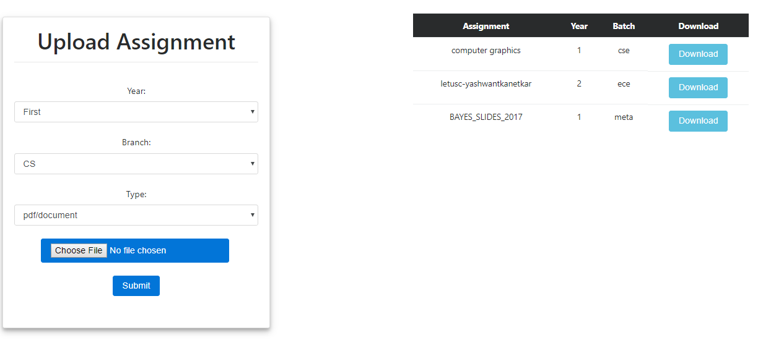
Assignments

Slide 7
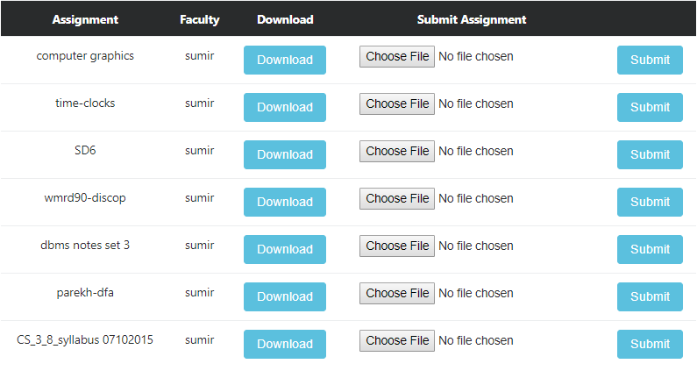
Submit Assignment

Slide 8
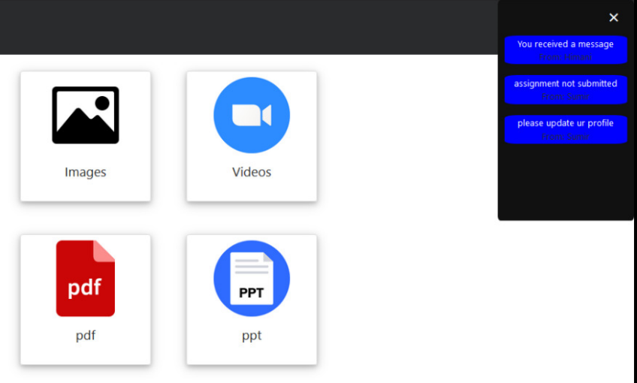
Notifications
Notifications are shown to user if he receives a message from someone.
Notification are shown to user when a teacher uploads an assignment.

Slide 9
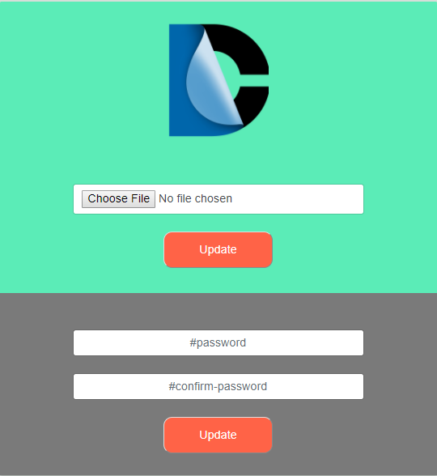
Profile Settings
User can update his profile picture after sign up and can update his profile in future as well.
User can change his password.

Slide 10
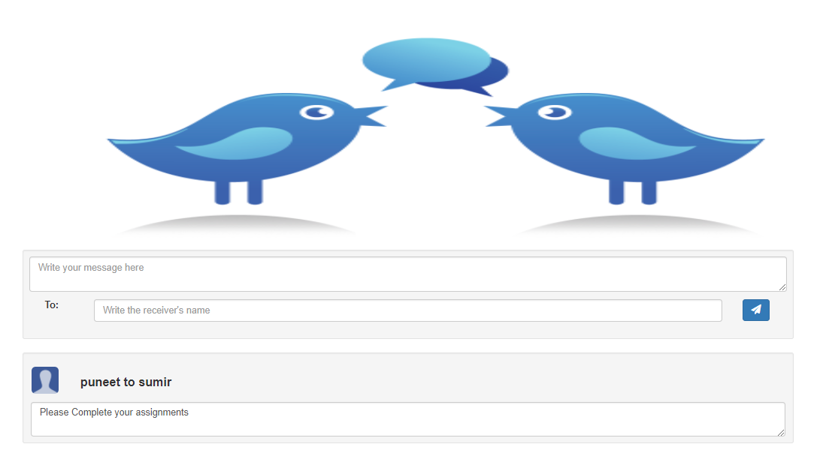
Discussion Portal
A common discussion portal for student and teacher.
A user can specify to whom he wants to send the message.
A user will receive notification on receiving message in his dashboard.

Slide 11
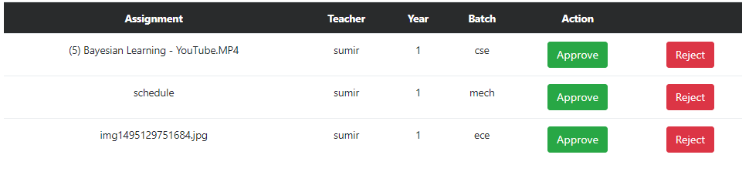
Admin Dashboard
Study Material uploaded by teacher needs to be approved by admin.
Admin can approve or reject a study material.

Slide 12
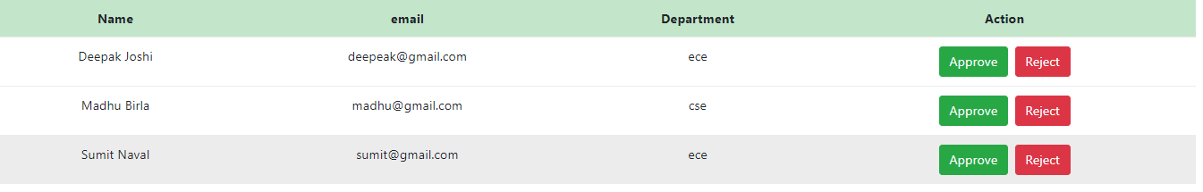
Admin Dashboard
Admin can approve or reject teacher’s account.

Slide 13
THANK YOU

